Slide 1

Department of Information Technology
NBA Accredited A.P. Shah Institute of Technology G. B . Road, Kasarvadavli , Thane(W), Mumbai-400615 UNIVERSITY OF MUMBAI Academic Year 2020-2021

Slide 2
A Project Report on IOT Enabled Social Web Framework for Water Consumption Mointoring Submitted in partial fulfillment of the degree of Bachelor of Engineering(Sem-8) in INFORMATION TECHNOLOGY By Krutika Pawar (18204012) Nakul Gagare (18204013) Deeksha Kadam(18204007) Under the Guidance of Prof.Yaminee Patil

Slide 3
1.Project Conception and Initiation

Slide 4
1.1 Abstract
Water is one of the essential part of life & in this era water quantity is one of big problem in the world.
In order to ensure the safe supply of the drinking & useful water for different purpose, the water should be monitored.
The system is designed to monitor the supply of water to a particular area which can detect the quantity of water supplied through that pump .
This system design is a real time monitoring of the quantity of water by using some sensor and software .

Slide 5
1.2 Objectives
To Develop the ecosystem for smart water supply
To get the quantity of water supplied to area and analysis the water level present in tank.
To observe the water supplied to area and analyze the water quality present in tank.
To analyze & helpful the water department the problem of water scarcity in the town.
To analyze this, the report can generate which can tell usage of water.
By using Elastic stack designing the dashboard for department end user.

Slide 6
1.3 Literature Review
Paper Title : An IOT-Based Water Supply Monitoring
Authors : Maruthi H V,Lakshmi Priya, Lavanya A R,Meda Manideep
Publication details : 2017 International Conference on Nextgen Electronic Technologies: Silicon to Software (ICNETS2)
Findings : According to scientists and organizations as IPCC (Intergovernmental Panel on Climate Change), state has come, since a long time, where water management as such implies to maximizing use of water and minimizing the wastage of water and thus preventing the domino effect cycle arises as wastage of water. The sensors will sense the flow of water to each pipe which ultimately tells the usage of water at one block ideally. This water usage data would be sent to cloud using the IOT (Internet of things) space. This cloud data would be sent to the concern resident’s person’s mobile app (application) reporting the water used and alerting the user to limit the water use if it gets extended to the limit usage set by municipal government or corporation. If the limit gets extended the user have to pay accordingly. This will be real time operation. The objective of doing so is for limiting and minimizing the usage of water for an average of per person. To appraise the IOT based water management, it can be ramified as diligent, frugal for water management in a symbiotic parity way, which will constrict the water resource evenly according to the in situ factors

Slide 7
1.3 Literature Review
Paper Title : Smart Water Monitoring System using IOT
Authors : Gowthamy J, Chinta Rohith Reddy, Pijush Meher, Saransh Shrivastava, Guddu Kumar.
Publication details : International Research Journal of Engineering and Technology (IRJET) e-ISSN: 2395-0056 Volume: 05 Issue: 10 — Oct 2018.
Findings : According to Use of water in the industries for many purposes such as fabricating, washing, cooling, processing, diluting, or product transportation; take in water into a product etc . One of the major food industries in India is Dairy industry and India is at first rank in the list of maximum major milk producing nation . Most of the milk processing unit use “Clean In Place” (CIP) system which pumps clean ing solutions through all equipments. At modern dairy processing plants, the milk: water ratiois 1:2.5 liters. However, the expected ratio is 1:0.7 liters . Thus, to achieve such a low consumption not only advanced equipments are required, but also very good housekeeping and awareness among both employees and management is also required. Monitoring water use is the regular collection of information about the total amount of water drawn from all sources for any use during a given period. For the water consuming industries it is important to monitoring usage of water for planning for minimize and awareness of water use.

Slide 8
1.3 Literature Review
Paper Title : Monitoring of Industrial Water Usage by using Internet of Things.
Authors : .Sourabh Jadhav Center for P.G. Studies, Visvesvaraya Technological University, Belagavi 2.Sneha Vijay Patil Center for P.G. Studies, Visvesvaraya Technological University, Belagavi 3. T.C. Thanuja Center for P.G. Studies, Visvesvaraya Technological University, Belagavi 4. M.P. Shivu FluxGen Engineering Technology, Bangalore 5. Ganesh Shankar FluxGen Engineering Technology, Bangalore..
Publication details : 2018 International Conference on Information , Communication, Engineering and Technology (ICICET)
Findings : This paper focuses on monitoring the amount of usage of water in the milk processing unit and generates report of the daily water usage in each processing section. The system keeps track of the purchased water, water in reservoir and overall usage of water in the milk industry. The flow sensors will sense the flow of water in each pipe which ultimately tells the usage of water at one block ideally This water usage data would be sent to the cloud using the Internet of Things (IoT) space. The cloud data is computed and generates pattern of the data input and provides a detailed water consumption chart on the desktop as well as smart phones.Industrialization impacts directly on the development of country. Water is essential for industries. The industrial water usage keeps on rising and in the year 2025 to 2050 it will reach around 8.5 and 10.1 percent of the total freshwater.

Slide 9
1.4 Problem Definition
We Observed that for the most part the Employment is manual and requires a sensible technology to give organized distribution.
To Convert the manual water supply reading system to a automated sensor used dashboard
No officer can change the reading which leads to corruption.

Slide 10
1.5 Technology stack
Hardware requirements:
Water Level Sensor
Arduino Uno -ATmega328
Wifi Module
Water Quality Sensor
Software Requirements :
Browser: Google chrome , Mozilla Firefox
Application : ELK Stack , HTML

Slide 11
1.6 Benefits for environment & Society
Get accurate reading and mapping of supply water in the town , by this no one can change the reading/mapping.
By using this we can analyze the wastage of water on yearly/monthly/daily basis that’s how we can save the water in future.

Slide 12
2. Project Design

Slide 13
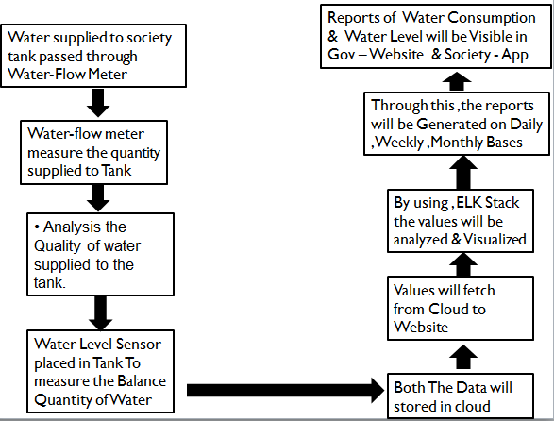
2.1 Proposed System

Slide 14
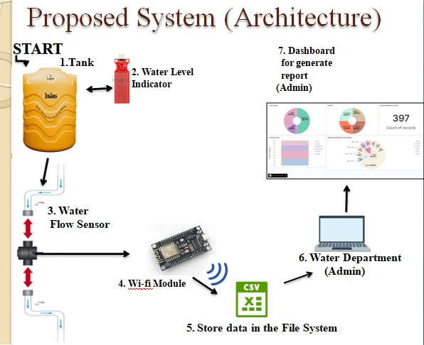
2.2 Design(Flow Of Modules)

Slide 15
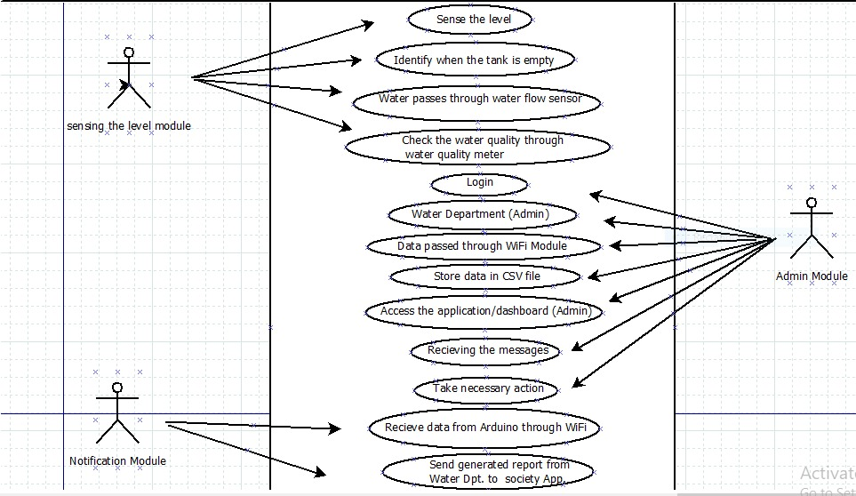
2.3 Description Of Use Case

Slide 16
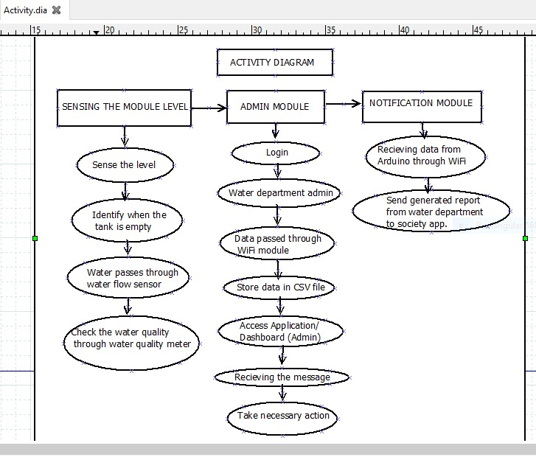
2.4 Activity diagram

Slide 17
3. Implementation

Slide 18
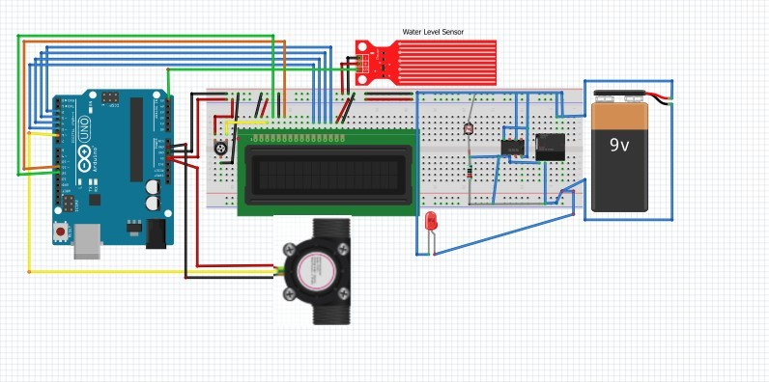
Circuit Diagram of measuring the level of water from a tank

Slide 19
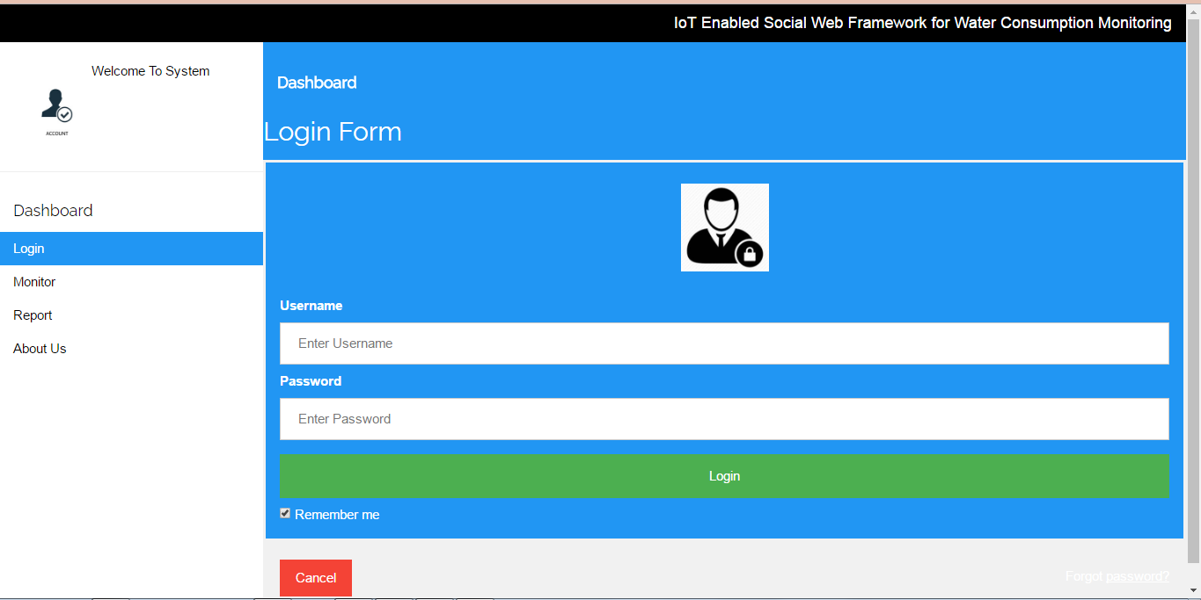
Website

Slide 20
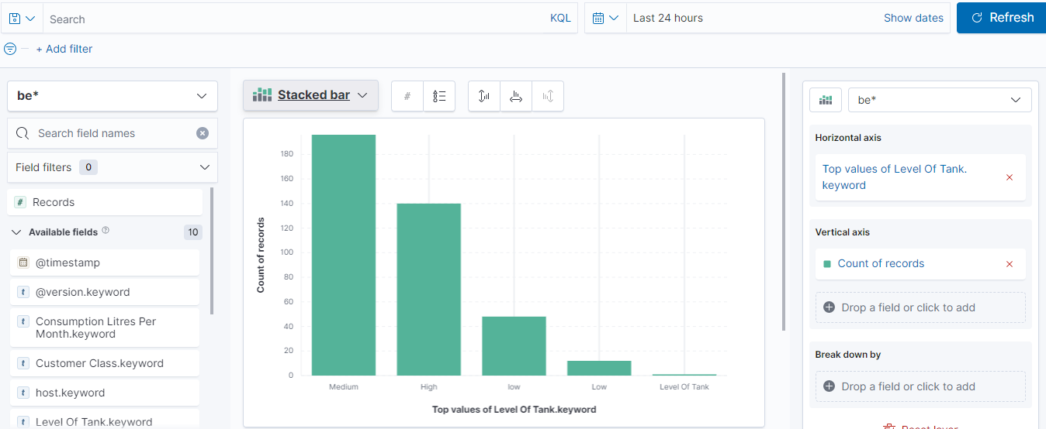
Visualization filter in kibana

Slide 21
4. Testing

Slide 22
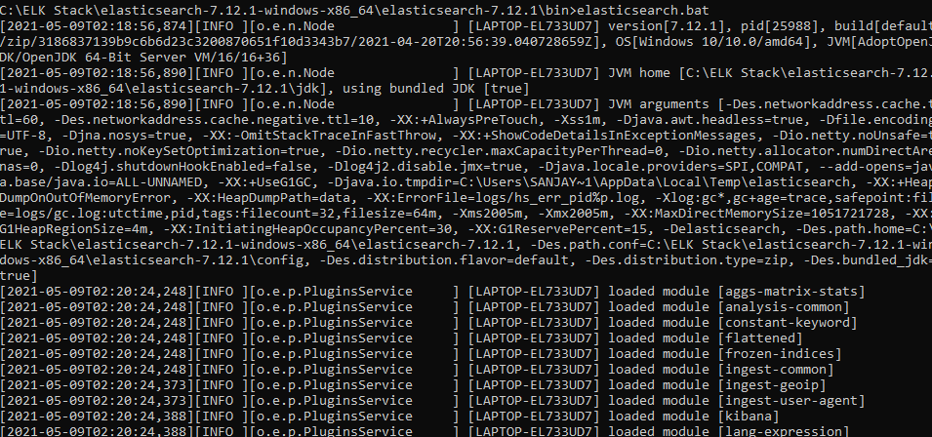
Running Elastic search on command prompt

Slide 23
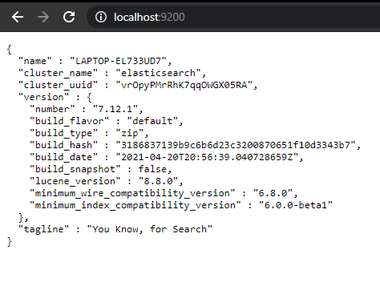
Elastic search running on browser

Slide 24
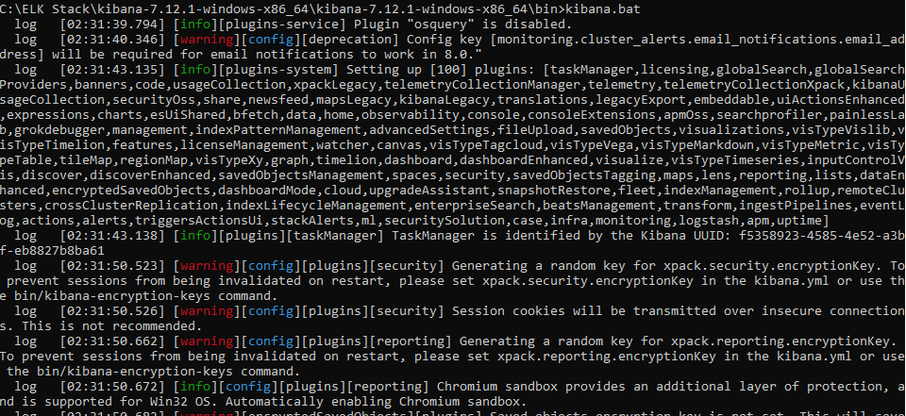
Running Kibana on command prompt

Slide 25
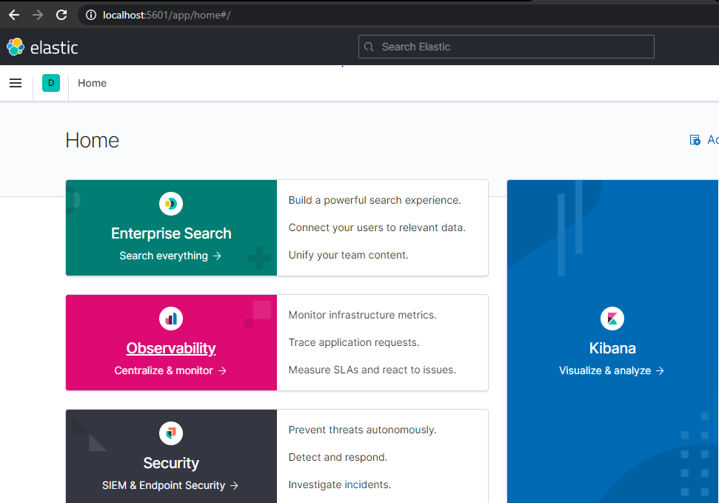
Kibana running on browser

Slide 26
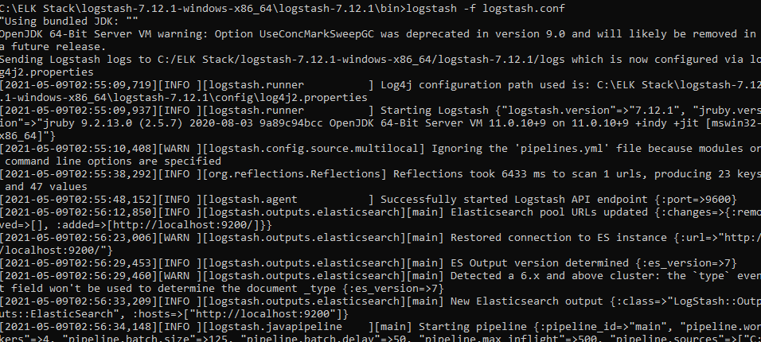
Running Logstash on command prompt

Slide 27
5. Result

Slide 28
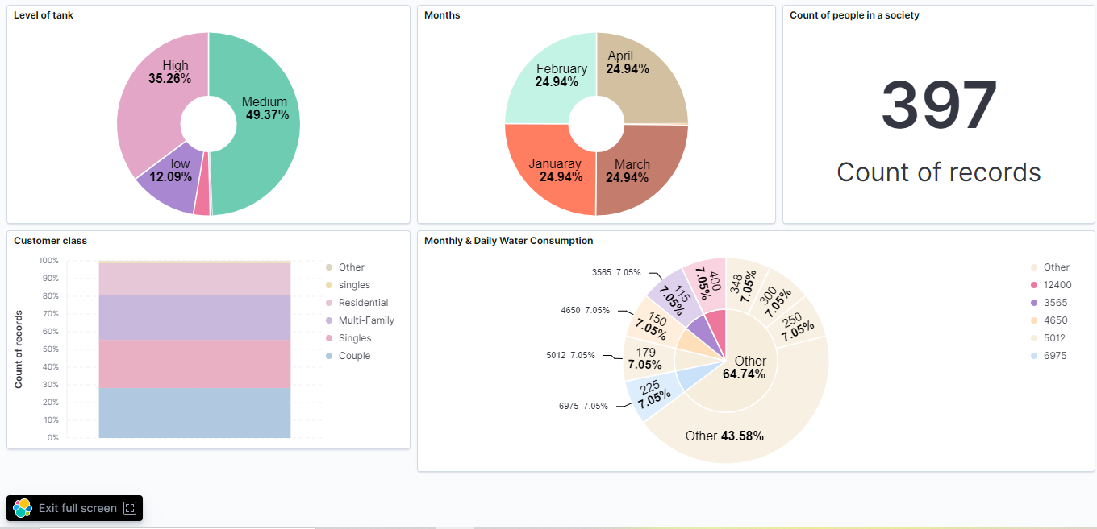
Dashboard created in kibana

Slide 29
6. Conclusion and Future Scope

Slide 30
Conclusion
The Internet has changed the size of life involving virtual interaction. IOT has the potential to feature new dimensions enabling smarter objects communications. The proposed system is a water level monitoring system with different levels indicated. System design and architecture which has been implemented in our project is very cost effective, a simple strategy to monitor the water level system . Saving water is also essential now-a-days looking over it we have created this idea.

Slide 31
Future Scope
Future Work can involve the analysis of water level during a particular area in order that the wastage of water is prevented. In future we are also planning to add PH scale to find out the quality of water, the quality of water, etc. It also symbolizes when the water level is as per requirement below or low.

Slide 32
References
Chef Soh, Z. H., Shafie, M. S., Shafie, M. A., Noraini Sulaiman, S., Ibrahim, M. N.,\& Afzal Che Abdullah, S. (2018). IoT Water Consumption Monitoring & Alert System. 2018 International Conference on Electrical Engineering and Informatics (ICELTICs)(44501). doi:10.1109/iceltics.2018.8548930
Siddula, S. S., Babu, P., & Jain, P. C. (2018). Water Level Monitoring and Management of Dams using IoT. 2018 3rd International Conference On Internet of Things: Smart Innovation and Usages (IoT-SIU). doi:10.1109/iot-siu.2018.8519843

Slide 33
Paper Publication
Paper entitled “IOT Enabled Social Web Framework for Water Consumption Monitoring” is presented at “My Easy Chair“, “Springer” by “Krutika Pawar , Nakul Gagare , Deeksha Kadam Prof . Yaminee Patil".

Slide 34
Thank You

